Slide 1
Introduction to Neural Networks
Computing Science
University of Alberta
Nilanjan Ray

Slide 2
Agenda
What is a Neural Net?
Neural net as a computational graph
Approximating “XOR” function with neural net
Understanding backpropagation
Universal function approximation by a neural net

Slide 3






Feed forward neural network
f is a non-linear function
g can also be non-linear
$$h_{1}=f(w_{11}x_{1}+w_{12}x_{2}+b_{1})$$
$$x_{1}$$
$$h_{2}=f(w_{21}x_{1}+w_{22}x_{2}+b_{2})$$
$$y=g(w_{1}h_{1}+w_{2}h_{2}+w_{3}h_{3}+b)$$
$$x_{2}$$
$$h_{3}=f(w_{31}x_{1}+w_{32}x_{2}+b_{3})$$
Input nodes
Output node
Hidden nodes

Slide 4
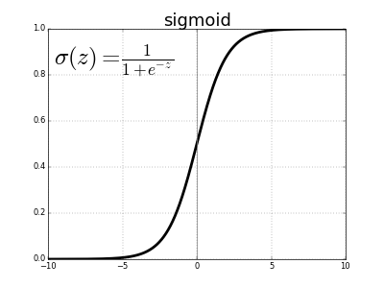
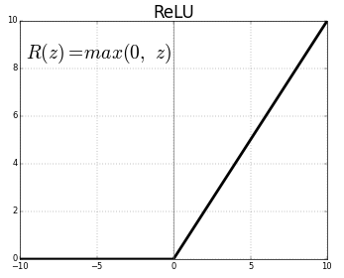
Feed forward net: non-linear functions
Non-linear functions at hidden nodes are known as “activation function”
Sigmoid, ReLU, ELU, ….
Why activation functions are non-linear?

Slide 5
Feedforward net in general: Directed acyclic graph
Input nodes
Hidden nodes
Output nodes

Slide 6
What’s the big deal about neural net?
Mathematically very rich: it can approximate any function
It is biologically inspired: (loosely) resembles brain connections
Computationally:
Simple: matrix-vector multiplication and point-wise non-linear function
Highly paralleizable: cuBLAS, GEMM, Batched GEMM!
Excellent empirical results on “generalization capability” over variety of applications!

Slide 7

Neural network as a computational graph
Input (4x2 matrix)
(4x8 matrix)
(4x8 matrix)
(4x8 matrix)
(4x1 vector)
(4x1 vector)
Output (4x1 vector)
X
Z₁ = XW₁
Z₂ = Z₁+b₁
Z₃ = σ(Z₂)
Z₄ = Z₃W₂
Z₅ = Z₄+b₂
*
+
σ
*
+
σ
Y^{p} = σ(Z₅)
Loss
W₁
b₁
W₂
b₂
Parameter (2x8 matrix)
Parameter (1x8 vector)
Parameter (8x1 vector)
Parameter (scalar)
Y
X
Y
Ideal output (4x1 vector)
$$σ\left(a\right)=\frac{1}{1+exp⁡(−a)}$$
This network is
trying to learn
XOR function
1 | 0 | 1
0 | 0 | 0
0 | 1 | 1
1 | 1 | 0
Sigmoid function;
applied pointwise
to a vector or matrix input

Slide 8
How does PyTorch optimize parameters?
By gradient descent PyTorch adjusts network parameters to reduce the value of the loss function.
But how?
Answer: Backpropagation
Let us learn how to do backpropagation on a computational graph!

Slide 9


Chain rule of derivative for a computational node
Z=f(X;W)
Z=f(X;W)
Z=f(X;W)
X
Z
Loss
Ideal output
W
(parameter)
$$\frac{∂(Loss)}{∂X}=\frac{∂Z}{∂X}\frac{∂(Loss)}{∂Z}$$
If X, Z, W are all scalars, then usual chain rule of derivative applies:
$$\frac{∂(Loss)}{∂W}=\frac{∂Z}{∂W}\frac{∂(Loss)}{∂Z}$$

Slide 10
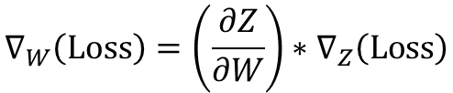
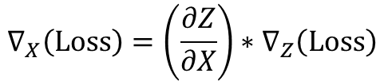
Chain rule of derivative…
Z=f(X;W)
Z=f(X;W)
Z=f(X;W)
X
Z
Loss
Ideal output
W
(parameter)
If X, Z, W are matrices or vectors, then :
$$∇_{X}\left(Loss\right)=\left(\frac{∂Z}{∂X}\right)∗∇_{Z}\left(Loss\right)$$
“*” refers to matrix vector multiplication
$$∇_{W}\left(Loss\right)=\left(\frac{∂Z}{∂W}\right)∗∇_{Z}\left(Loss\right)$$

Slide 11


Example 1
1x2 vector
scalar
X=[x1, x2]
Z =XW= x1w1+x2w2
*
2x1 vector
W=[w1, w2]^{T}
Chain rules:
$$∇_{X}\left(Loss\right)=W^{T}\frac{∂(Loss)}{∂Z}=\left[\begin{matrix}w1 & w2\end{matrix}\right]\frac{∂(Loss)}{∂Z}$$
Why?
$$∇_{W}\left(Loss\right)=X^{T}\frac{∂(Loss)}{∂Z}=\left[\begin{matrix}x1 \\ x2\end{matrix}\right]\frac{∂(Loss)}{∂Z}$$

Slide 12


Example 2
1x2 vector
1x3 vector
X
Z=XW
Matrix-vector
multiplication:
*
2x3 matrix
W
$$∇_{X}\left(Loss\right)=∇_{Z}(Loss)W^{T}$$
Chain rules:
Why?
$$∇_{W}\left(Loss\right)=X^{T}∇_{Z}(Loss)$$

Slide 13



Backprop derivation
1x2 vector
1x3 vector
X
Z=XW
Matrix-vector
multiplication:
*
2x3 matrix
W
$$∇_{X}\left(Loss\right)=∇_{Z}(Loss)W^{T}$$
Using short
notation for
gradients:
$$δX=δZW^{T}$$
Chain rules:
$$∇_{W}\left(Loss\right)=X^{T}∇_{Z}(Loss)$$
$$δW=X^{T}δZ$$
$$δS≡∇_{S}(Loss)$$

Slide 14

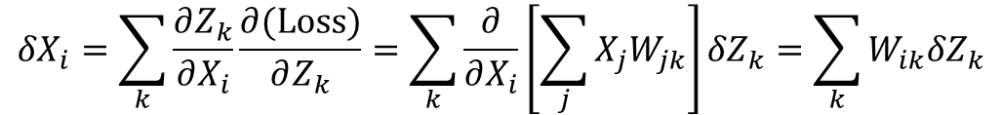
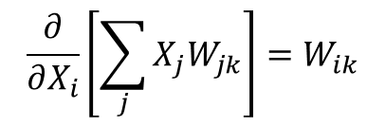
Backprop derivation…
$${δX}_{i}=\sum_{k}{\frac{∂Z_{k}}{∂X_{i}}\frac{∂(Loss)}{∂Z_{k}}}=\sum_{k}{\frac{∂}{∂X_{i}}\left[\sum_{j}{{X_{j}W}_{jk}}\right]{δZ}_{k}=\sum_{k}{W_{ik}{δZ}_{k}}}$$
$$δX=δZW^{T}$$
i^{th} component
of δX vector
Because,
Writing in matrix-vector
multiplication form
Substitute Z_{k}
$$\frac{∂}{∂X_{i}}\left[\sum_{j}{{X_{j}W}_{jk}}\right]=W_{ik}$$
Chain rule of derivative
k^{th} component
of δZ vector

Slide 15
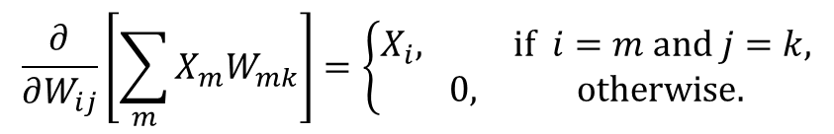
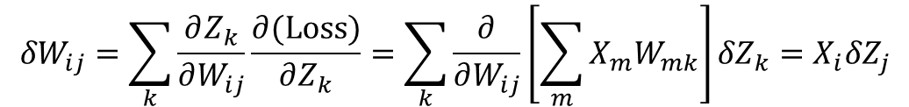

Backprop derivation…
$${δW}_{ij}=\sum_{k}{\frac{∂Z_{k}}{∂W_{ij}}\frac{∂(Loss)}{∂Z_{k}}}=\sum_{k}{\frac{∂}{∂W_{ij}}\left[\sum_{m}{{X_{m}W}_{mk}}\right]{δZ}_{k}=X_{i}{δZ}_{j}}$$
$$δW=X^{T}δZ$$
Writing in matrix-vector
multiplication form
(i,j)^{th} component
of δW matrix
Because,
Substitute Z_{k}
$$\frac{∂}{∂W_{ij}}\left[\sum_{m}{{X_{m}W}_{mk}}\right]=\left\{\begin{matrix}X_{i}, if i=m and j=k, \\ 0, otherwise.\end{matrix}\right.$$
Chain rule of derivative
k^{th} component
of δZ vector

Slide 16

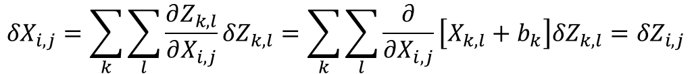
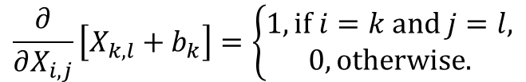
Backprop derivation…
(4x8 matrix)
(4x8 matrix)
X
Z = X+b
“Broadcast” addition:
+
Parameter (2x1 vector)
b
$${δX}_{i,j}=\sum_{k}{\sum_{l}{\frac{∂Z_{k,l}}{∂X_{i,j}}{δZ}_{k,l}}}=\sum_{k}{\sum_{l}{\frac{∂}{∂X_{i,j}}\left[X_{k,l}+b_{k}\right]{δZ}_{k,l}}}={δZ}_{i,j}$$
$$δX=δZ$$
Substitute Z_{k, l}
Because,
Chain rule
$$\frac{∂}{∂X_{i,j}}\left[X_{k,l}+b_{k}\right]=\left\{\begin{matrix}1, if i=k and j=l, \\ 0, otherwise.\end{matrix}\right.$$

Slide 17
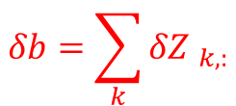
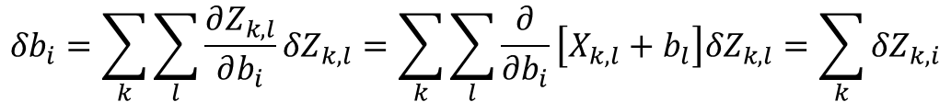
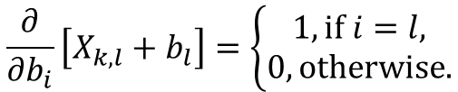
Backprop derivation for broadcast addition
(2x8 matrix)
(2x8 matrix)
X
Z = X+b
“Broadcast” addition:
+
Parameter (1x8 vector)
b
$${δb}_{i}=\sum_{k}{\sum_{l}{\frac{∂Z_{k,l}}{∂b_{i}}{δZ}_{k,l}}}=\sum_{k}{\sum_{l}{\frac{∂}{∂b_{i}}\left[X_{k,l}+b_{l}\right]{δZ}_{k,l}}}=\sum_{k}{{δZ}_{k,i}}$$
$$δb=\sum_{k}{{δZ }_{k,:}}$$
Substitute Z_{k, l}
Because,
Chain rule
$$\frac{∂}{∂b_{i}}\left[X_{k,l}+b_{l}\right]=\left\{\begin{matrix}1, if i=l, \\ 0, otherwise.\end{matrix}\right.$$

Slide 18
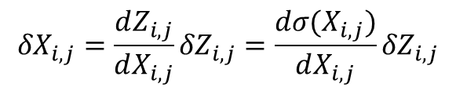


Backprop derivation for activation function
X
Z = σ(X)
$${δX}_{i,j}=\frac{dZ_{i,j}}{dX_{i,j}}{δZ}_{i,j}=\frac{dσ(X_{i,j})}{dX_{i,j}}{δZ}_{i,j}$$
Non-linear function:
(applied pointwise)
σ
Using chain rule:
If the non-linear
function is sigmoid,
$$σ\left(a\right)=\frac{1}{1+exp⁡(−a)}$$
$$\frac{dσ}{da}=\frac{exp⁡(−a)}{{(1+exp⁡(−a))}^{2}}=\frac{1}{1+\exp\left(−a\right)}\left(1−\frac{1}{1+\exp\left(−a\right)}\right)=σ(a)(1−σ(a))$$
$${δX}_{i,j}=σ(X_{i,j})(1−σ(X_{i,j})){δZ}_{i,j}$$

Slide 19
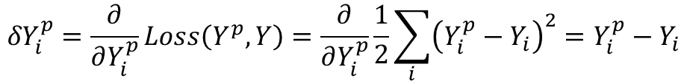
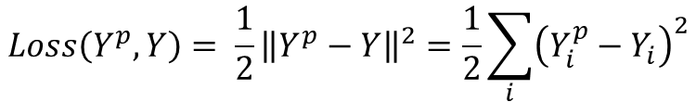

Backprop derivation for loss function
Euclidean loss function:
$$Loss\left(Y^{p},Y\right)= \frac{1}{2}{\left\|Y^{p}−Y\right\|}^{2}=\frac{1}{2}\sum_{i}{{\left(Y_{i}^{p}−Y_{i}\right)}^{2}}$$
$${δY}_{i}^{p}=\frac{∂}{∂Y_{i}^{p}}Loss\left(Y^{p},Y\right)=\frac{∂}{∂Y_{i}^{p}}\frac{1}{2}\sum_{i}{{\left(Y_{i}^{p}−Y_{i}\right)}^{2}}=Y_{i}^{p}−Y_{i}$$
i^{th} component of δY^{p} vector:
Using vector notation:
$$δY^{p}=Y^{p}−Y$$

Slide 20











Apply chain rule to XOR neural network
Input (4x2 matrix)
(4x8 matrix)
(4x8 matrix)
(4x8 matrix)
(4x1 vector)
(4x1 vector)
X
Z₂ = Z₁+b₁
Z₃ = σ(Z₂)
Z₄ = Z₃W₂
Z₅ = Z₄+b₂
Output (4x1 vector)
Z₁ = XW₁
*
+
σ
*
+
σ
Y^{p} = σ(Z₅)
δZ₁
δZ₂
δZ₃
δZ₄
δZ₅
δW₁
δb₁
δW₂
δb₂
δY^{p}
Loss
W₁
b₁
W₂
b₂
Parameter (2x8 matrix)
Parameter (1x8 vector)
Parameter (8x1 vector)
Parameter (scalar)
Y
Ideal output (4x1 vector)
Chain rule of derivatives:
$$δY^{p}=Y^{p}−Y$$
$$δW_{2}=Z_{3}^{T}δZ_{4}$$
$$δZ_{5}=σ(Z_{5})(1−σ(Z_{5}))δY^{p}$$
$$δb_{2}=\sum_{k}{{(δZ_{5})}_{k}}$$
$$δZ_{4}=δZ_{5}$$
Gradient of “Loss”
with respect to
input signals
Gradient of “Loss”
with respect to
parameters
$$δZ_{3}=δZ_{4}W_{2}^{T}$$
$$δW_{1}=X^{T}δZ_{1}$$
New notation:
$$δZ_{2}=σ(Z_{2})(1−σ(Z_{2}))δZ_{3}$$
$$δb_{1}=\sum_{k}{{(δZ_{2})}_{k,:}}$$
$$δS≡∇_{S}(Loss)$$
Propagates backward
$$δZ_{1}=δZ_{2}$$

Slide 21


Backprop to train a neural net
Initialize all parameters of the neural network
Initialize learning rate variable lr
If loading the whole training data, do it once
outside the “Iterate” loop, to be efficient
Iterate:
(Load Data): Get training data batch
(Forward pass): Compute Z₁, Z₂,…,Y^{p}
(Backward pass): Compute gradients δY^{p}, δZ₅,…, δZ₁, δW₂, δW₁, δb₂, δb₁
(Gradient descent to update parameters):
$$W_{2}←W_{2}−lr∗δW_{2},$$
$$b_{2}←b_{2}−lr∗δb_{2},…,$$
(Diagnostics): Compute “Loss” from time to time to check if it is decreasing
“Learn_XOR_manualBP.ipnyb” implements this learning algorithm

Slide 22
PyTorch magic!
Fortunately, PyTorch can automatically compute derivatives by chain rules!
Also, it has several optimizers that can use these derivatives in the gradient descent optimization method.
Look at “Learn_XOR.ipnyb” and “Learn_XOR_with_LBFGS.ipnyb”

Slide 23
Universal function approximation
A neural network with a single hidden layer can approximate “any” function!
Wikipedia has a clear statement: https://en.wikipedia.org/wiki/Universal_approximation_theorem
A non-technical explanation of universality theorem:
http://neuralnetworksanddeeplearning.com/chap4.html
Why do we then even need multiple layers and why even deep nets?

